Slide 1
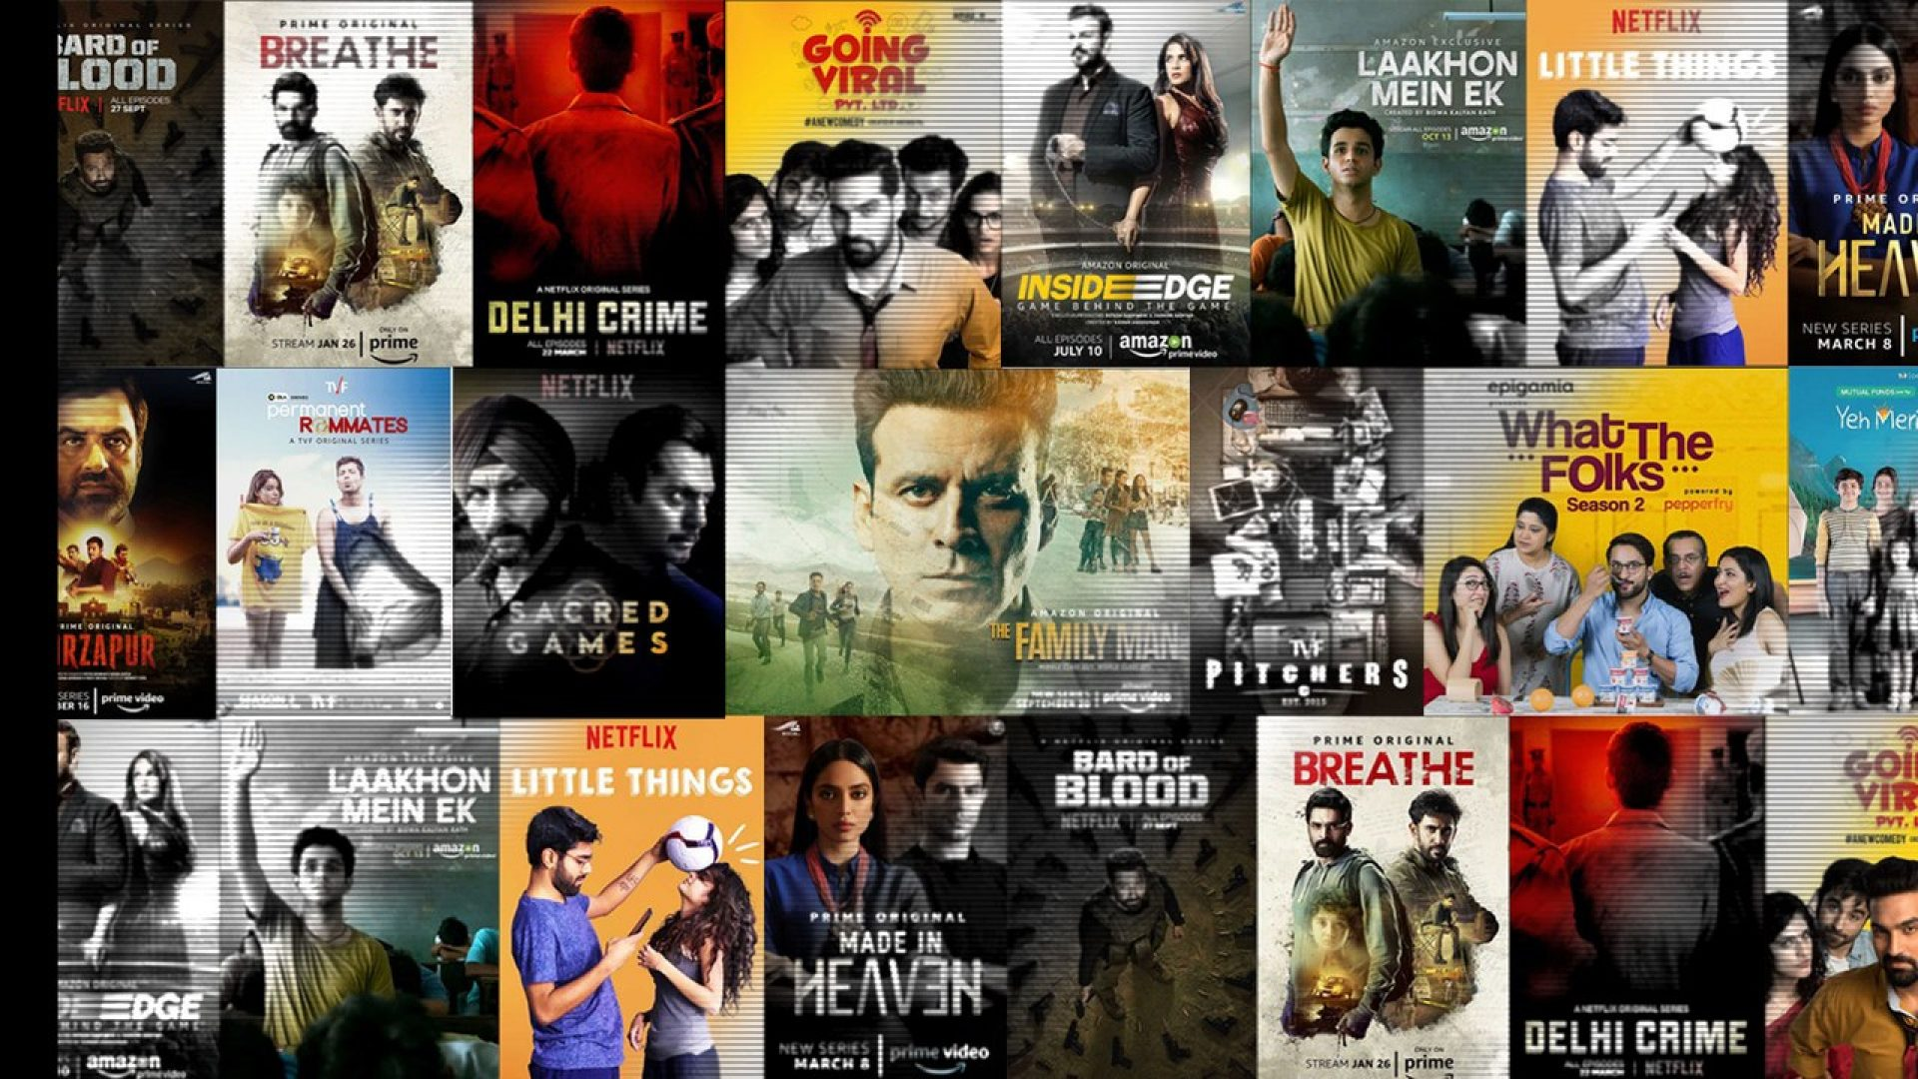
MTH208A - Data Science Lab 1
Project Presentation
By Group No 7:
Arijit Dey
Kaushik Thakkar
Kumar Kanishk Singh
Shailza Sharma
Under the guidance of Dr. Dootika Vats

Slide 2



Introduction:
Our Project
Why Indian Web Series?

Slide 3









Data Scraping:
1. Source:
2. Data Scrapped:
Data about top web series of various Indian web series streaming platforms. Viz.
https://www.imdb.com

Slide 4






3. Problems tackled while scrapping:
a) Lots of missing values.
b) Getting entries corresponding to episodes of web series instead of web series as a whole.

Slide 5














Data frame description:
Total no of columns scrapped: 14
Total number of rows : 302

Slide 6
Adding two more columns:
a) Certificate Category:
Family and Kids
Teenagers
Adults
12+, UA
7+, U, 7+
UA 16+, UA, U/A, PG, 16+, 16, 13, 15+, UA 13+
18+, 18, A
b) Length Category:
Short Length Web series
Medium Length Web series
Long Length Web series
Length less than 20 min
Length between 20 min and 40 min
Length more than 40 min

Slide 7

Interesting Questions that can be asked:
Which certificates and genre of web series are the most popular amongst people?
Does length of a web series affect the engagement of audience with the web series?
Is there any potential difference between the preferences of males and females when it comes to web series?
Which genre works best in which platform ?
Which platform targets which age group?

Slide 8
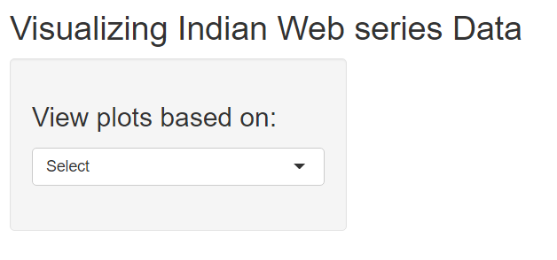
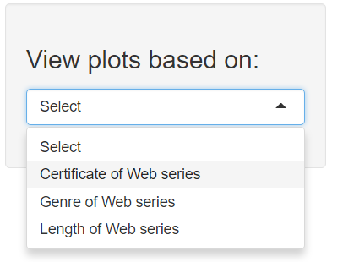
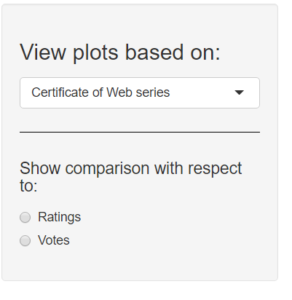
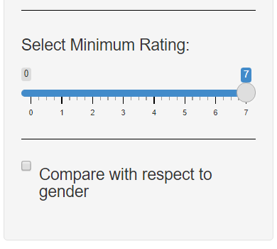
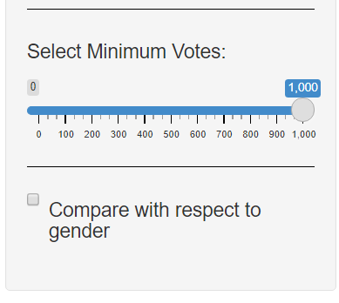
Description of Shiny App (Sidebar Panel):
Select one option from the drop down menu
Each containing a check box for comparing the results with respect to gender
Select one option from the radio button
Selecting
‘Votes’
Selecting
‘Ratings’

Slide 9
Description of Shiny App (Main Panel):
Bar plots with various combination of inputs coming from the input panel are shown in the main panel.
After selecting this two options, a bar plot is shown
This same thing happens for all six combination of Input1 and Input2
Adds a side-by-side bar plot with gender classification under the above plot

Slide 10
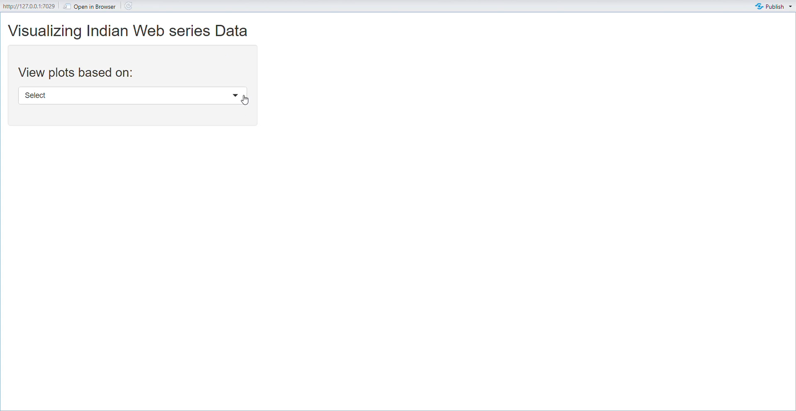
Description of Shiny App:
Let’s see the shiny app in action:

Slide 11
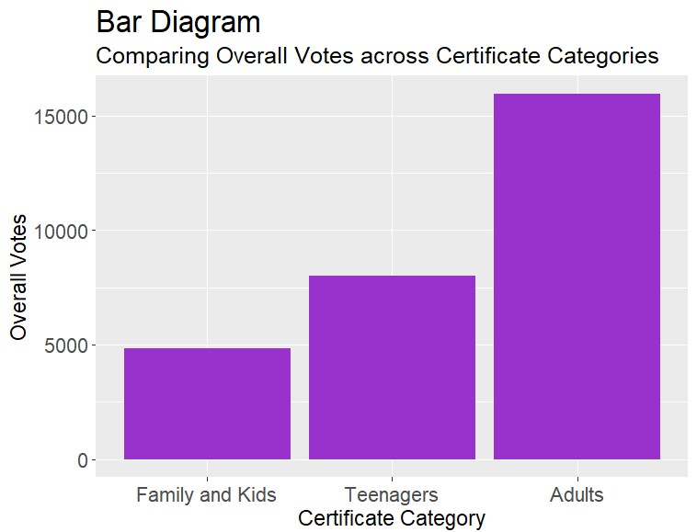
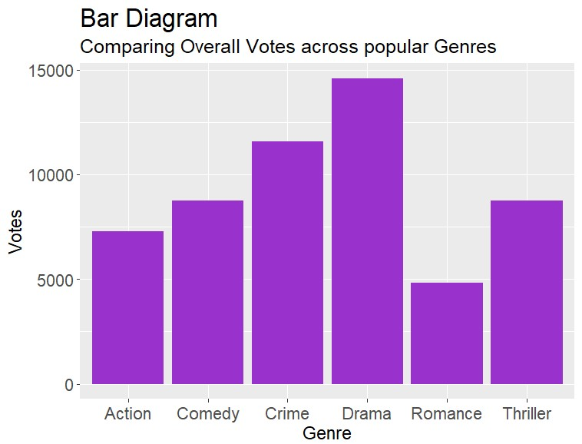
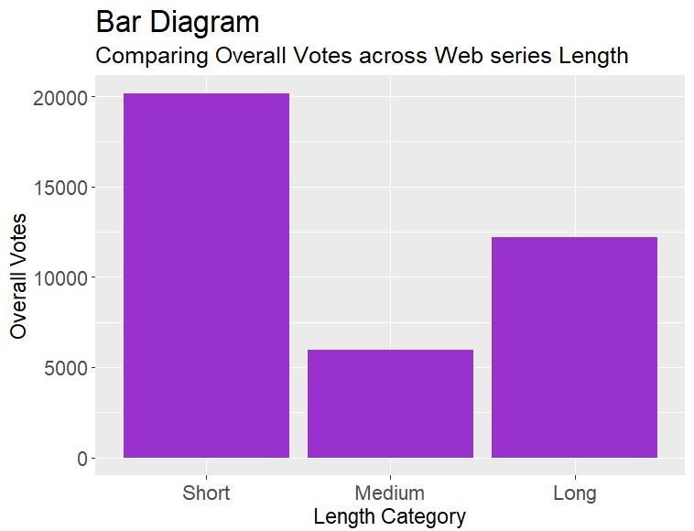
Visualization we got:
Input 1 : Plot Based on Certificate
Input 2 : Plot with respect to Votes
Input 1 : Plot Based on Genre
Input 2 : Plot with respect to Votes
Input 1 : Plot Based on Length
Input 2 : Plot with respect to Votes
1. Most Voted Genre
2. Most Voted Certificate
3. Most Voted Length

Slide 12
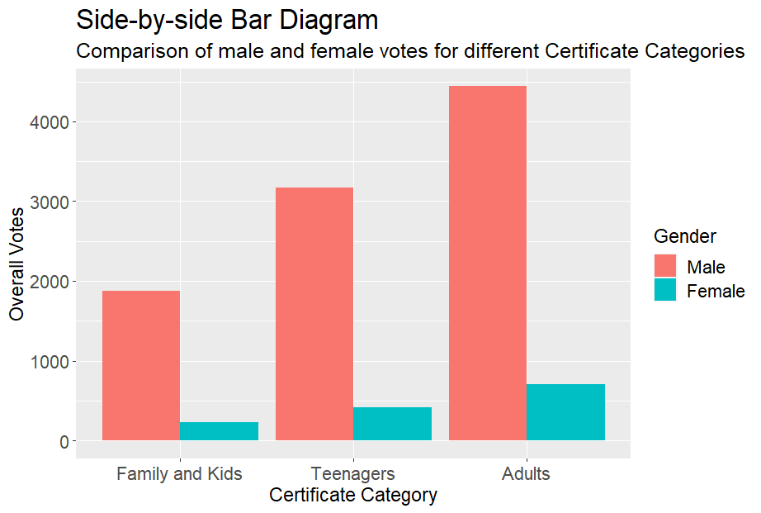
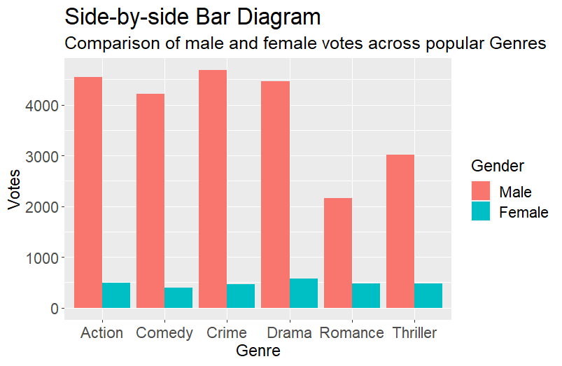
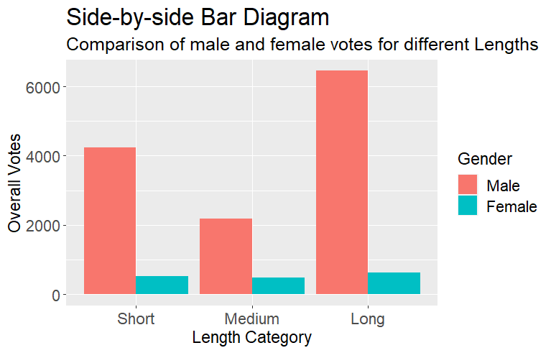
Visualization we got:
Input 1 : Plot Based on Certificate
Input 2 : Plot with respect to Votes
Male-Female Checkbox Selected
Input 1 : Plot Based on Genre
Input 2 : Plot with respect to Votes
Male-Female Checkbox Selected
Input 1 : Plot Based on Length
Input 2 : Plot with respect to Votes
Male-Female Checkbox Selected
5. Votes given by women are invariably less than men.

Slide 13

Visualization we got:
Input 1 : Plot Based on Genre
Input 2 : Plot with respect to Votes
Male-Female Checkbox Selected
Input 1 : Plot Based on Genre
Input 2 : Plot with respect to Votes
6. Most voted genre is ‘Drama’ but for male ‘Crime’ and ‘Action’ dominates this.

Slide 14
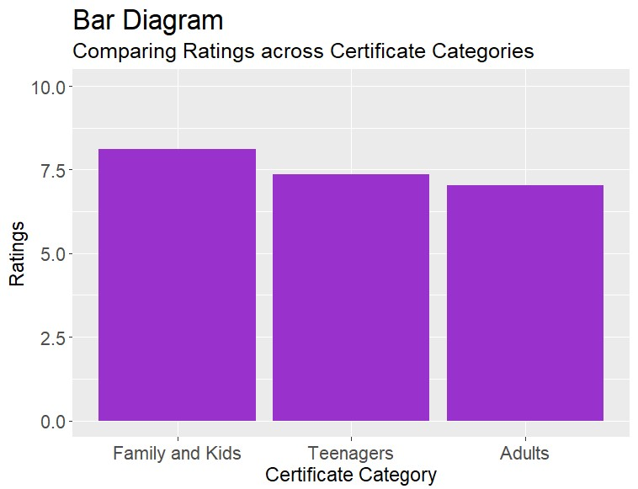

Visualization we got:
Input 1 : Plot Based on Certificate
Input 2 : Plot with respect to Ratings
Input 1 : Plot Based on Certificate
Input 2 : Plot with respect to Votes
7. Quality of web series of different certificate category is more or less same but most watched category is ‘Adults’.

Slide 15
Conclusion:
We got some important visualizations
But,
1. No Statistical Analysis
2. Results only on the basis of pure data visualization
3. No conclusive proof

Slide 16
Thank You

